Slide 1
INTRODUCTION TO INFORMATION AND COMMUNICATION TECHNOLOGIES Course Code: CS-117 ICT – LAB: 1
COURSE

Slide 2
About Instructor
Hello!
I AM ZAIN UL ABIDEEN KAMBOH
I am here because I am going to teach you guys this lab.
YOU CAN CONTACT ME AT:
EMAIL: zainulabideenkamboh@gmail.com

Slide 3
Course Outline
Weeks | Mid Exam Topics | Weeks | Final Exam Topics
Week-1 | Introduction to ICT | Week-10 | Databases and Information Systems
Week-2 | Microsoft Word, Excel and Powerpoint | Week-11 | Networks and Data Communication
Week-3 | Core Concepts of Computer | Week-12 | The Internet, Browsers and Search Engines
Week-4 | Windows and Linux Operating System | Week-13 | Collaborative Computing and Social Networking
Week-5 | Hardware and Software Basics | Week-14 | IT Security and other issues
Week-6 | Storage Devices and Computer Architecture | Week-15 | HTML and CSS
Week-7 | Number Systems | Week-16 | Final Exam
Week-8 | Introduction to Programming
Week-9 | Mid Exam

Slide 4
MARKS DISTRIBUTION
There will be in total around 14 lab sessions, a mid exam and a final exam (16 weeks in total). There will be 100 marks.
Following is the breakup:
30 mid (will be held in 9th week of semester)
20 sessional - assignments, lab tasks
50 final exam ( will be held on 16th week of semester, before theory final exams start)

Slide 5
What is Computer?
Computer is an electronic device.
Can store large amounts of data.
Can performing operations on data.
Performing given function on the data & displays the result as output.
Process data whenever needed.
Known from ‘to compute’

Slide 6
What is Process?
Computer works on data as per program is called process.
Processing means operations like…
Calculations.
Logical decision making.
Outputting data.
Communicating with others computer etc.

Slide 7
Charactristics
Speed
Automation
Accuracy
Reliability
Storage
Retrieving data
Arithmetical and logical operations
Versatility (flexible)
Consistency
Communications

Slide 8
What is ICT?
Information and communication technologies is the technology required for information processing, in particular, the use of electronic computers, communication devices and software applications to convert, store, protect, process, transmit and retrieve information from anywhere, anytime.
Information and communication technologies generally refers to all devices networking components, applications, systems that facilitate interaction with the digital world. ICT is more comprehensive including more components related to computers and digital technologies.
Information and communication technologies are the technologies used in the conveying, manipulation and storage of data by electronic means.

Slide 9
Information and Communication Technologies
Information:
Information refers to the knowledge obtained from reading, investigation, study or research. The tools to transmit information are the telephone, television and radio. Information is knowledge and helps us to fulfil our daily tasks.
Communication:
Communication is an act of transmitting messages. It is a process whereby information is exchanged between individuals using symbols, signs or verbal interactions. Communication is important in order to gain Knowledge.
Technology:
Technology is the use of scientific knowledge, experience and resources to create processes products that fulfil human needs. Technology is vital in communication.

Slide 10
ICT...
There are four ‘i’s in ICT as under:
Information: ideal entity or essence of something, thought, proposition, concept
Interactivity: it is the dialogue that occurs between a human being and a computer programme
Identity: social identity that an internet user establishes in online communities and websites
Informatics: academic field encompassing information science, information technology etc.

Slide 11
ICT…
There are four ‘c’s in ICT as under:
Connectivity: access to information
Capability: to use the new tools
Content: relevant, useful forms, need based, life experiences of the learners, local language, good quality
Cost: significantly facilitating adoption

Slide 12
ICT - Characteristics
Effectiveness:
• Most interactive
• Fewer errors
• Customized
• Personalized
• Archivable
• Transparent
Efficiency:
• Faster
• Cheaper
• Fewer steps
• Less people
• Less paper work
Innovations:
• New products
• New techniques

Slide 13
What is Communication?
Communication is simply the act of transferring information from one place to another.
Exchanging information from computer to another computer
The classic communication system is made up of an information source, an encoder, a transmitter, a receiver, a decoder, storage, retrieval, and an information destination.

Slide 14

Synchronous Communication
Online chat
Text based
Audio based
Video based
Mobile technology
Conferencing
Phone
Satellite
Television channel
Video conferencing

Slide 15
Asynchronous Communication
Discussion forums
Blogs
E-groups
Wikipedia (knowledge base)
Google (search engine)
Mobile SMS, MMS & podcasting

Slide 16
Advantages of ICT
Resource sharing
Wide variety of services
Flexibility
Reliability
Faster speed
Cheaper cost
Creation of jobs
Bridging the cultural gap
Develops communication

Slide 17
Disadvantages of ICT
New level of crime.
Automation tools and robots can displace workers.
Too expensive to afford
Computer viruses
Reliability of information

Slide 18
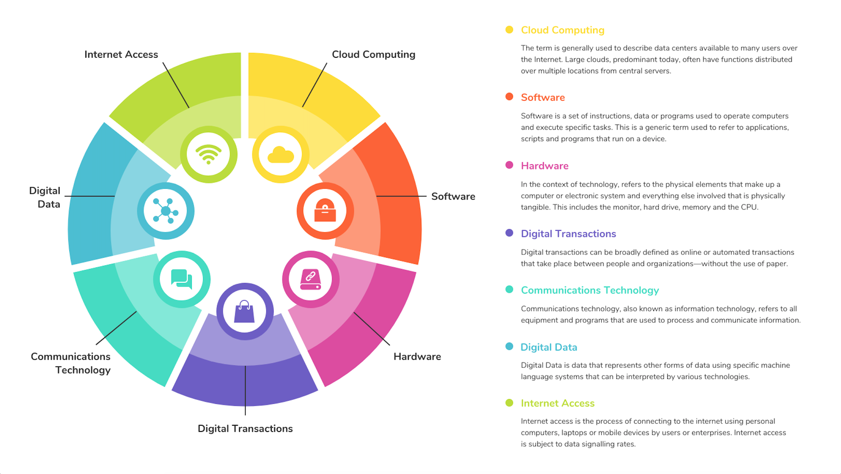
Components of ict

Slide 19
IT vs ict
IT refers to an entire industry that uses computers, networking, software and other equipment to manage information.
ICT can be seen as an integration of it with media broadcasting technologies, audio/video processing and transmission and telephony.
ICT is an extended acronym for it.

Slide 20
Applications
Any program you run on your computer
• microsoft word
• google chrome
• note application
.Exe (windows) or .App (mac) file
Can use without knowing how it works behind the scenes (abstraction) programs are written in code, the next layer of abstraction

Slide 21
TYPES OF VIRUS
File infector:
Attaches itself to program files i.e Files that give instructions to a computer.
Boot sector:
Stores itself at the start of a disk and becomes activated by reading, starting or restarting the computer when that disk is in the boot drive.
Trojan horses
Some hidden, generally malicious functionality that the computer does not expect.

Slide 22
Any question?

Slide 23
Thank you!

